Slide 1
Galaxies as a Population I
ASTR 503/703

Slide 2
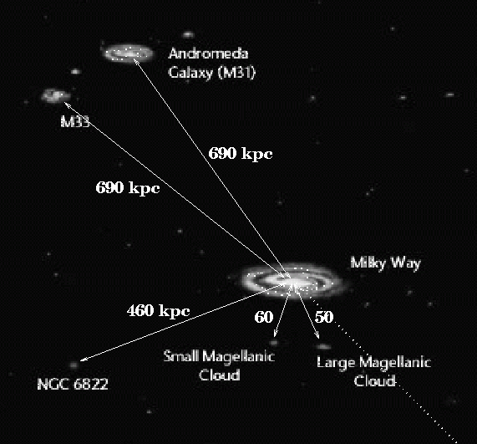
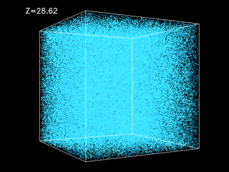
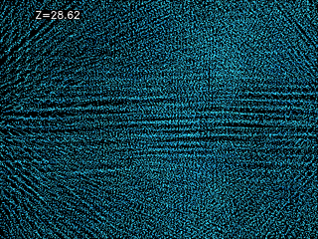
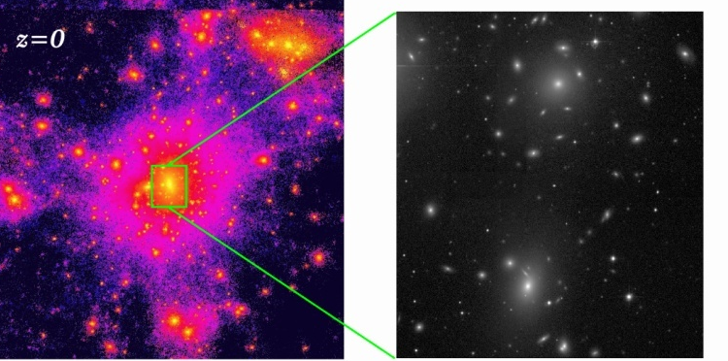
Hierarchical Galaxy Formation
dark matter halos merge & grow
Local Group
galaxies form within dark matter halos
http://cosmicweb.uchicago.edu/
figure: R. Jansen, ASU
Credit: R. Jansen
galaxies form inside
high-resolution physics:
galaxy-galaxy interactions
gas inflow & star formation
energy feedback (supernovae, AGN)
Moore www.nbody.net

Slide 3
Alternating spheroid & disk growth
time →
Lacey & Cole 1993
“merger tree”

Slide 4
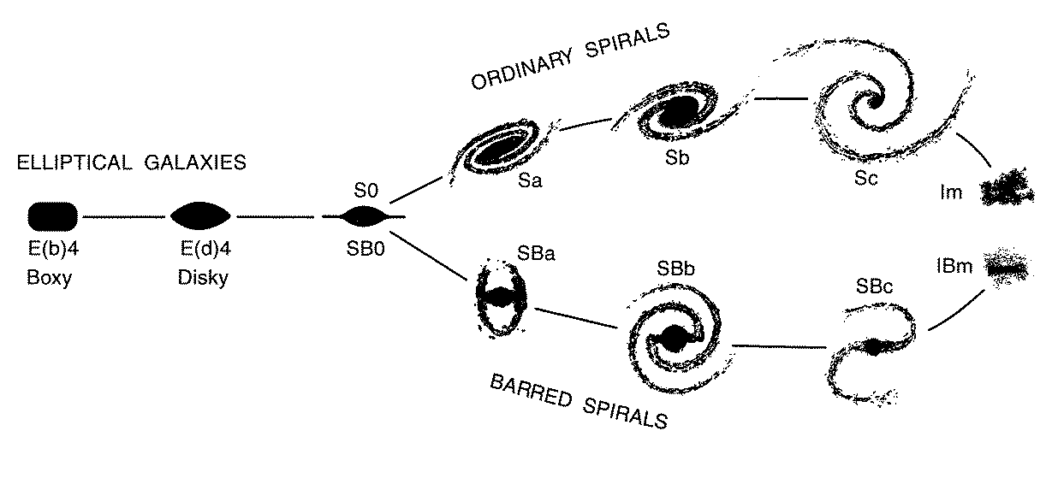
Evolution in the Hubble Sequence
E/S0s = “spheroids”
figure: Kormendy & Bender 1996
gas infall and disk growth
gas-depleting mergers & interactions

Slide 5
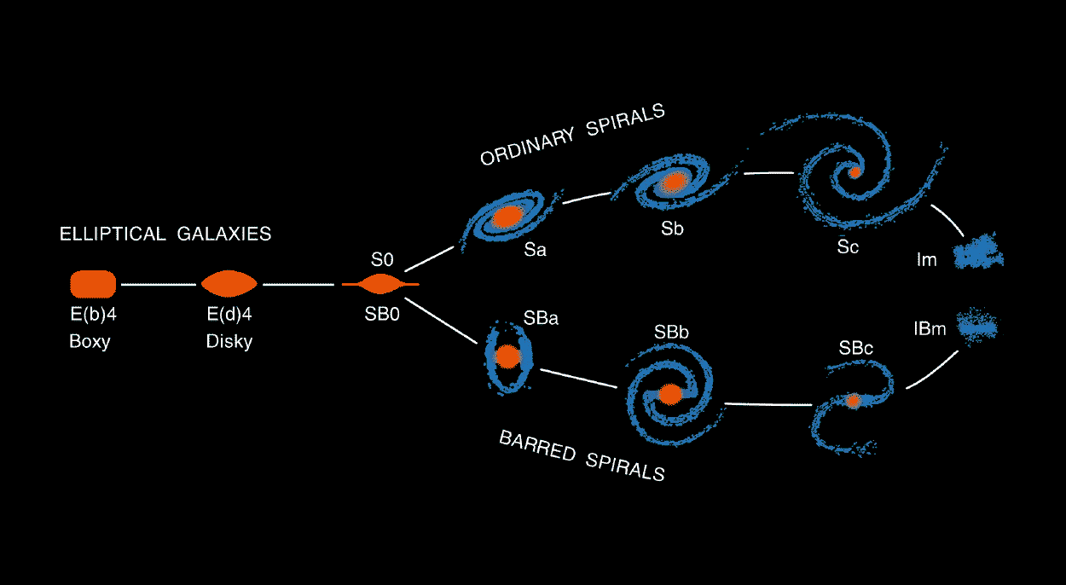
Properties in the Hubble Sequence
By “definition”: less spheroid, more (thin) disk, more rotation
By association: more cold gas & young stars, bluer

Slide 6
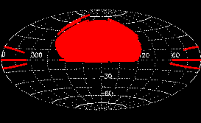
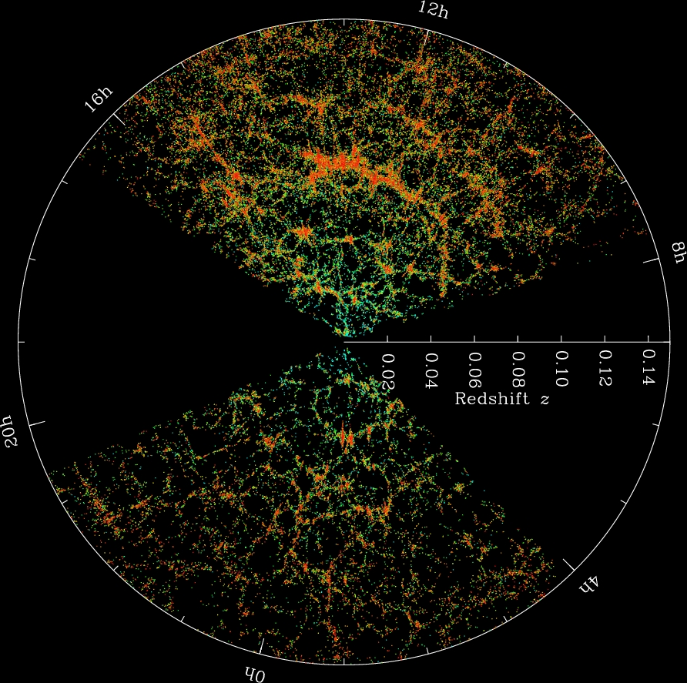
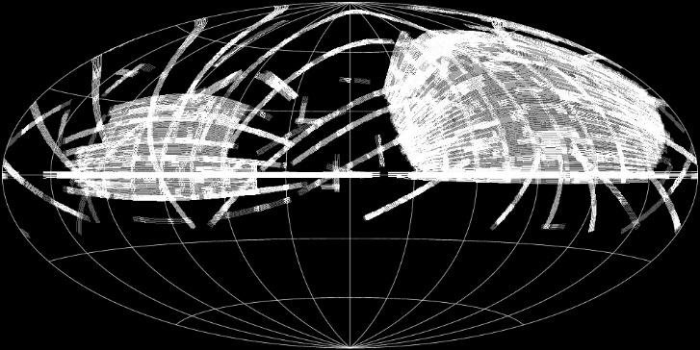
Sloan Digital Sky Survey (SDSS)
Original (“Legacy”)
Survey Sky Footprint
SDSS redshift survey slices: each dot is a galaxy
Expanded Imaging
Survey Sky Footprint
Large-Scale Structure (LSS):
voids, filaments, walls, groups/clusters

Slide 7
Sloan Digital Sky Survey (SDSS)
http://www.sdss.org/
Original (“Legacy”)
Survey Sky Footprint
SDSS redshift survey slices: each dot is a galaxy
http://cosmicweb.uchicago.edu/
Expanded Imaging
Survey Sky Footprint
http://www.sdss.org/
Large-Scale Structure (LSS):
voids, filaments, walls, groups/clusters

Slide 8
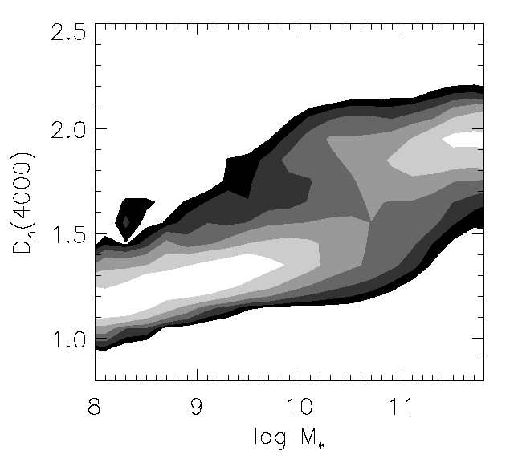
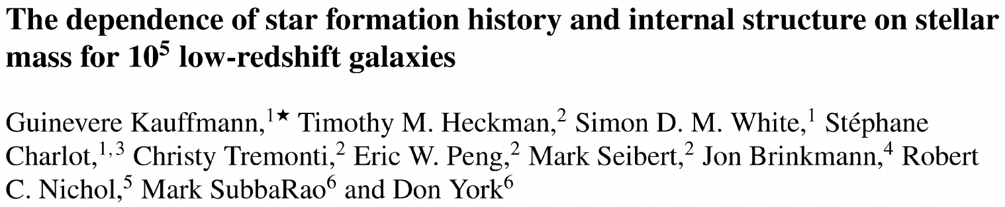
Survey science ➔ discovery of “bimodality mass”
M_{b}
Rediscovery of dwarf and giant galaxies? Or something new?
bimodality, not smooth shift
reframed in terms of fundamental quantities – mass not light – connect with theory (M_{b}=10^{10.5}M)
mainstream use of advanced statistics, Bayesian modeling
old
star form’n history tracer
Kauffmann et al. 2003
bursty
log galaxy stellar mass

Slide 9
Survey science ➔ discovery of “bimodality mass”
Rediscovery of dwarf and giant galaxies? Or something new?
bimodality, not smooth shift
reframed in terms of fundamental quantities – mass not light – connect with theory (M_{b}=10^{10.5}M)
mainstream use of advanced statistics, Bayesian modeling
old
star form’n history tracer
Kauffmann et al. 2003
bursty
log galaxy stellar mass

Slide 10
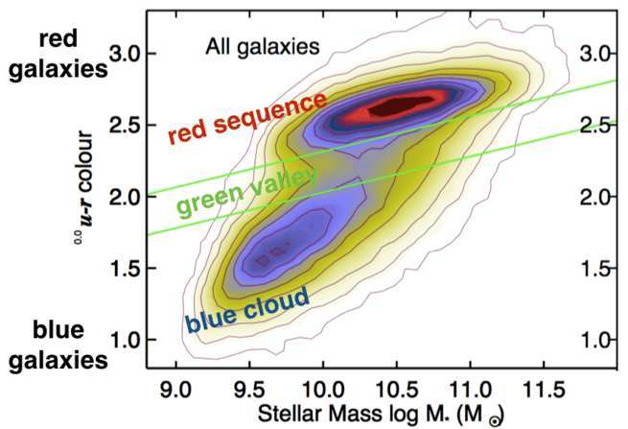
Color-stellar mass sequences
Schawinski et al. 2014
conditional probability distribution hides inverse square law bias (SDSS is flux-limited a.k.a. magnitude-limited)

Slide 11
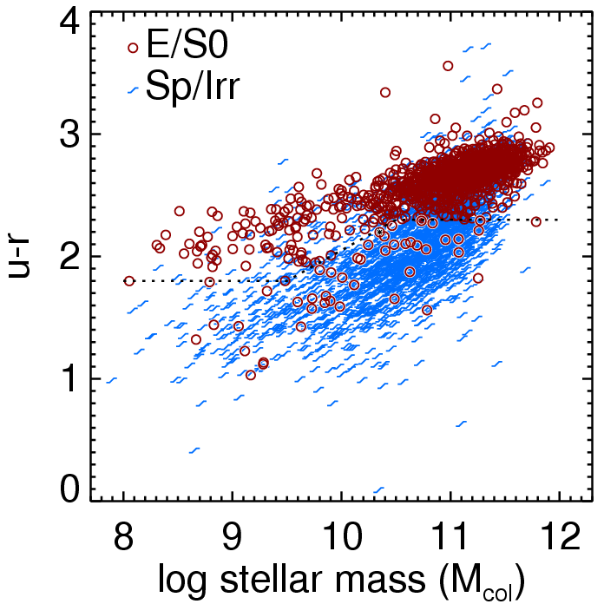
Color-stellar mass sequences
redder
Schawinski et al. 2014
conditional probability distribution hides inverse square law bias (SDSS is flux-limited a.k.a. magnitude-limited)
actual data points are “giant heavy” →
bluer
Kannappan et al. 2009
◉

Slide 12
Color-stellar mass sequences
blue seq. = growing, disky
red seq. = ‘red & dead’ spheroids
redder
Schawinski et al. 2014
conditional probability distribution hides inverse square law bias (SDSS is flux-limited a.k.a. magnitude-limited)
actual data points are “giant heavy” →
bluer
Kannappan et al. 2009
◉

Slide 13
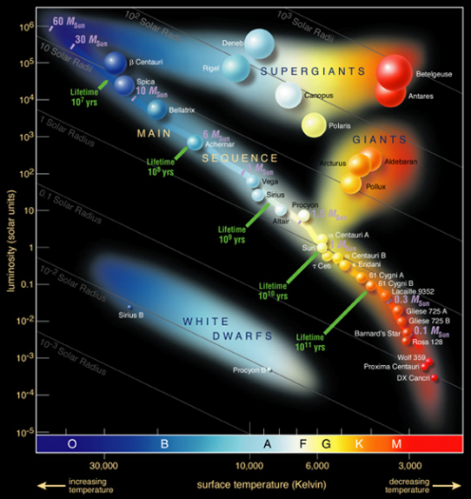
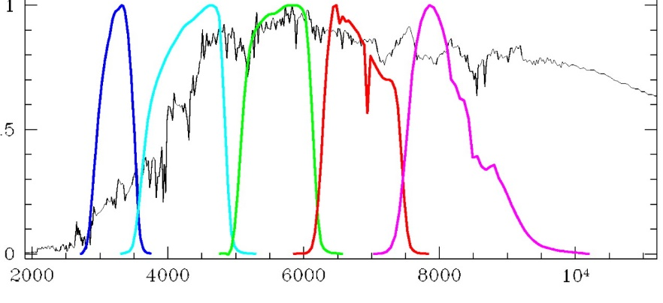
Color-stellar mass sequences
HR diagram of
stellar population
blue seq. = growing, disky
red seq. = ‘red & dead’ spheroids
why u-r?
traces stellar population age (and secondarily metallicity)
redder
Credit: ESO
Middle-aged galaxy with “4000 Angstrom break”
bluer
Kannappan et al. 2009
u
r
Filter Response
Blanton et al. 2003
◉
Wavelength (Angstroms)

Slide 14
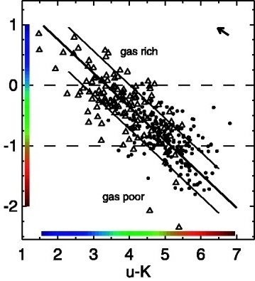
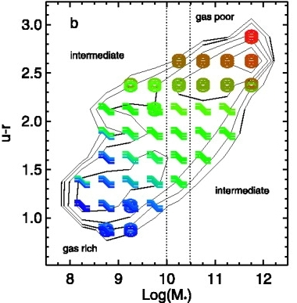
How does gas fit into this picture?
Log₁₀ of gas-to-stellar mass ratio
Kannappan 2004
21cm “HI” gas masses from homogenized literature data (346 galaxies)
gas content for 35,000 cross- matched SDSS-2MASS galaxies using color-based “shortcut” for stellar masses
near-infrared from all-sky 2MASS Survey

Slide 15
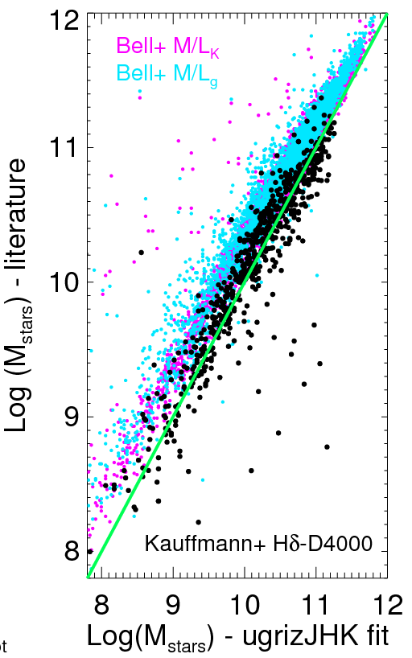
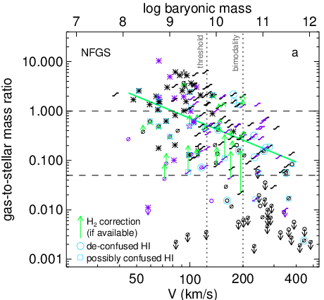
Hindsight: the gas-richness threshold mass is not the bimodality mass
= stars + gas
Problem:
color-based masses were systematically higher than Kauffmann masses (Kannappan & Gawiser 07)
Kannappan+ 2013
Nearby Field Galaxy Survey (200 galaxies)
Lesson for posterity: Huge data sets do not mitigate systematic errors. They just multiply them – many, many times over.

Slide 16
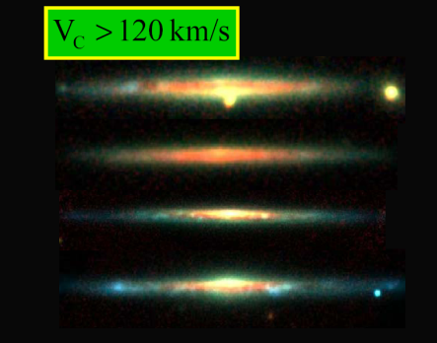
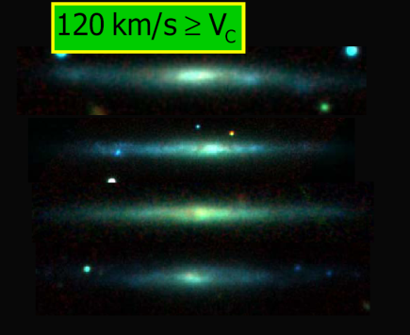
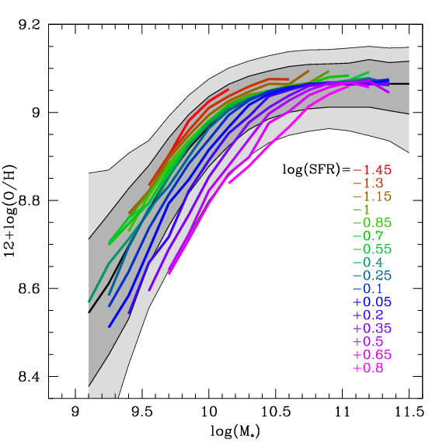
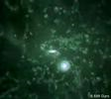
Threshold mass = known interstellar medium (ISM) transition scale
dust lanes
Link to theory of “cold-mode” gas accretion
Dalcanton et al. (2004)
Dekel & Birnboim (2005)
mass-metallicity relation
Mannucci et al. (2011)
update to “fundamental metallicity relation” including Star Formation Rate (SFR)
open box merger simulation
L. Mayer & the N-Body Shop

Slide 17
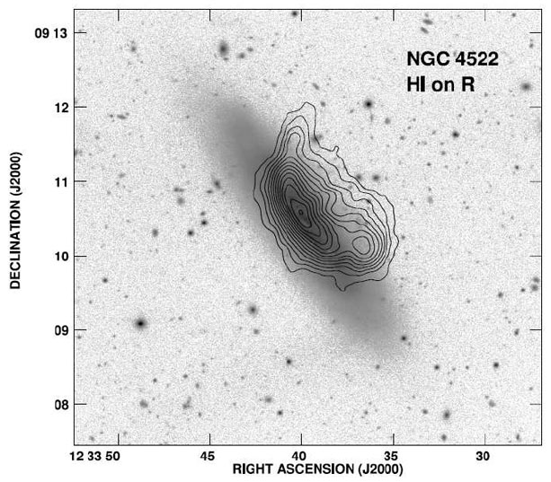
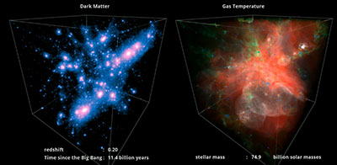
The hierarchical galaxy formation (non)paradox: why massive things are old
Peak initial overdensities in dark matter coalesce first
Even where largest halos are still coalescing today (galaxy clusters), the stars are already old → structure age ≠ stellar population age
Gas shock-heats in massive halos ➔ slows accretion, plus hot halo gas strips galaxy gas
old
star form’n history tracer
bursty
log galaxy stellar mass
Credit: Illustris Collaboration
Kenney et al. 2004

Slide 18
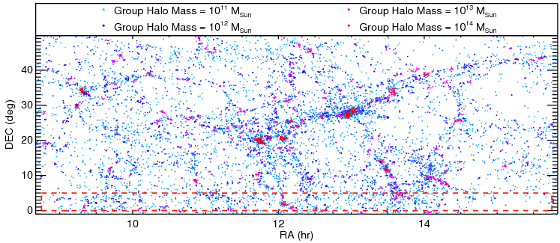


Motivation for RESOLVE & ECO
ECO
http://resolve.astro.unc.edu
= your data sets for this class
(real research in progress!)
RESOLVE-A
In brief:
two volume-limited, unusually complete “census” surveys of stars, gas, and dark matter, plus star formation & merging, from dwarf galaxy to group & cluster scales
Key advantages of both RESOLVE and ECO:
baryonic mass limit ~10⁹ M, well below threshold scale
volume-limited for robust & diverse environment data
more complete than parent SDSS
superior photometry (color gradients, star formation histories)
Additional benefits of RESOLVE:
fractional-mass limited gas masses (<10% stellar mass)
3D spectroscopy for internal dynamics & star formation
superior depth and archival data in equatorial strips
Complementary benefit of ECO:
>10x larger volume with more extreme environments

